Slide 1



Gravıty game
2020510158 Ali Özgür İnep
2021510060 İmdat Sönmez
2021510070 Ege Yıldırım
2021510122 Talha Mustafa Antep

Slide 2

CONTENTS *INTRODUCTION *PROGRESS SUMMARY *ALGORITHM AND SOLUTION STRATEGIES *PROBLEMS ENCOUNTERED *SCREENSHOTS *CONCLUSION *REFERENCES

Slide 3

WHAT IS THE PURPOSE OF THE PROJECT?

Slide 4

REQUIREMENTS TASK SHARING
CODE
DEBUG
REPORT
SLIDES
VIDEO
TEAM WORK
TEAM WORK
TEAM WORK
İMDAT SÖNMEZ
EGE YILDIRIM

Slide 5





SCHEDULING
1.WEEK 2.WEEK 3.WEEK 4.WEEK 5.WEEK
 |  | Computer movements
Design of classes and data structures
Player movements
Input queue implementation.
Boulder fall
Remaining parts of the game
Design of menu and screen
Timing
Testing/debugging
Game Initializations
Backpack implementation
Slides, video, report

Slide 6

COMPLETED TASKS
CODING
Design of classes, data structures, menu and screen
Game Initializations.
Player and Robot Movements
Rocks Moving and Other Details
DEBUGGING
REPORT, SLIDES, VIDEO

Slide 7

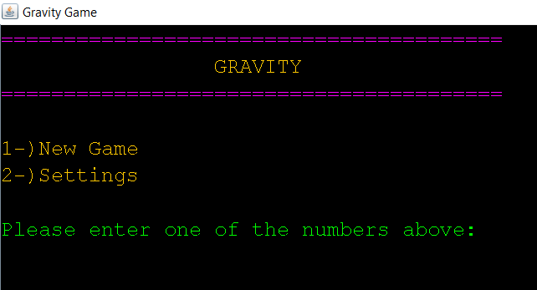
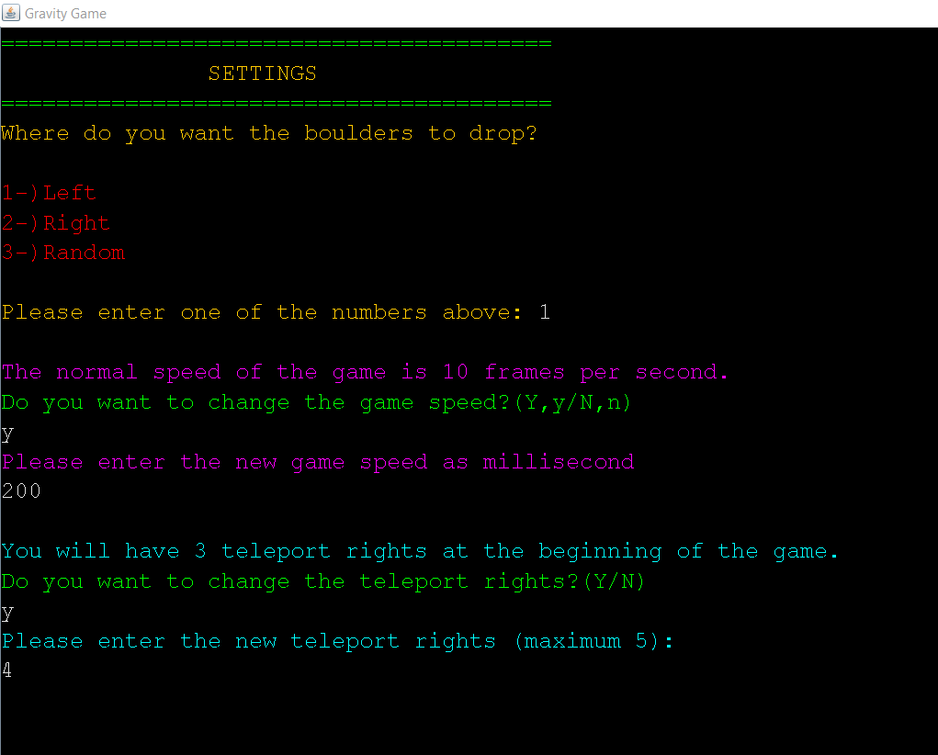

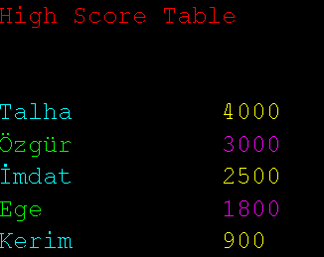
ADDITIONAL IMPROVEMENTS
Metin eklemek için tıklayın
Metin eklemek için tıklayın
Before the game starts, a menu welcomes you and the game rules are displayed
At the end of the game the name is entered and written in the highscoretable.
Some features in the game can be changed
in Settings like gamespeed,teleport rights.

Slide 8

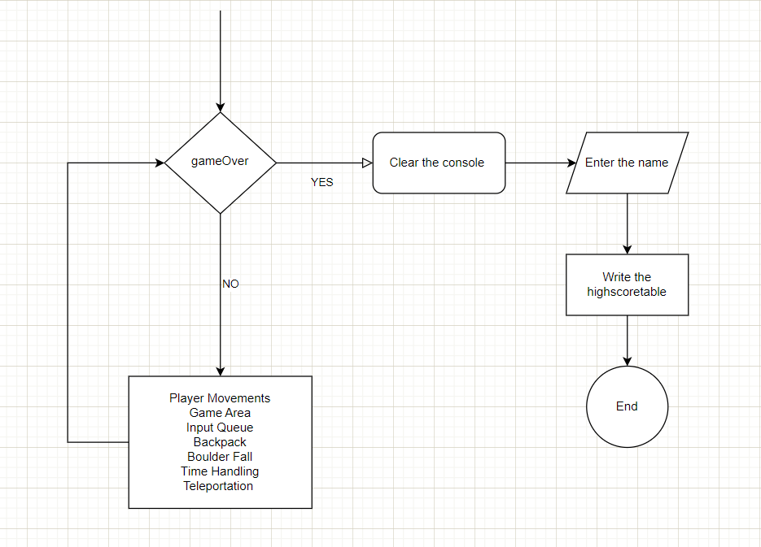
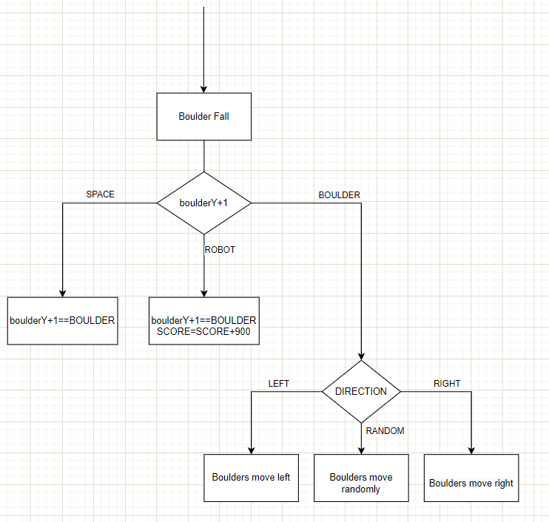



ALGORITHM AND SOLUTION STRATEGIES
Metin eklemek için tıklayın
Metin eklemek için tıklayın
Metin eklemek için tıklayın
Main Solution
Boulder Fall

Slide 9






PROBLEMS ENCOUNTERED
1.Communication
2.Some display errors
3.Robot and Queue Interaction

Slide 10
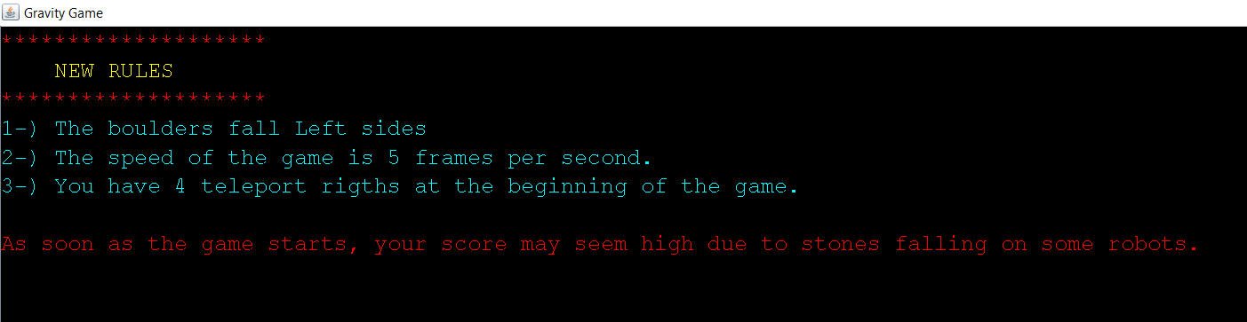
SCREENSHOTS

Slide 11
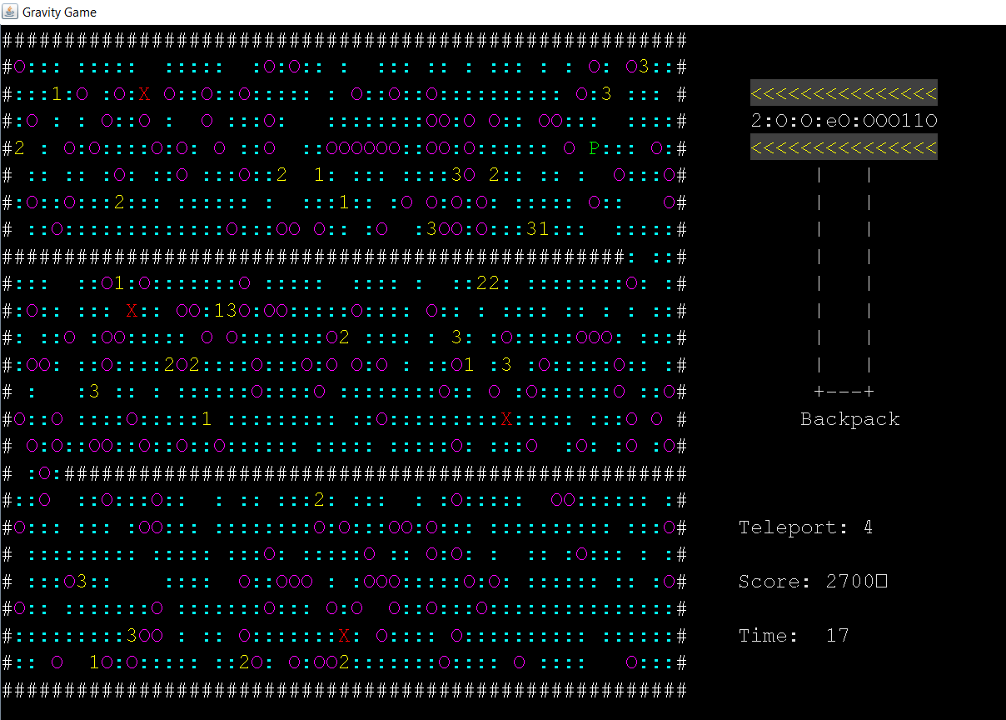

Slide 12



CONCLUSION ...

Slide 13

REFERENCES
https://www.w3schools.com
https://stackoverflow.com
https://www.geeksforgeeks.org

